Slide 1

Vision Based Volumetric Flow Measurement for wastewater and Storm water Networks
SeyedMojtaba Noghabaei
North Carolina State University

Slide 2
Outline
Overview
Unity Model
Model Generation
Analysis
Mixed Reality
GitHub Repository

Slide 3


Unity Model
Cross-Platform System
Windows
Android
IOS
MR/VR/AR

Slide 4
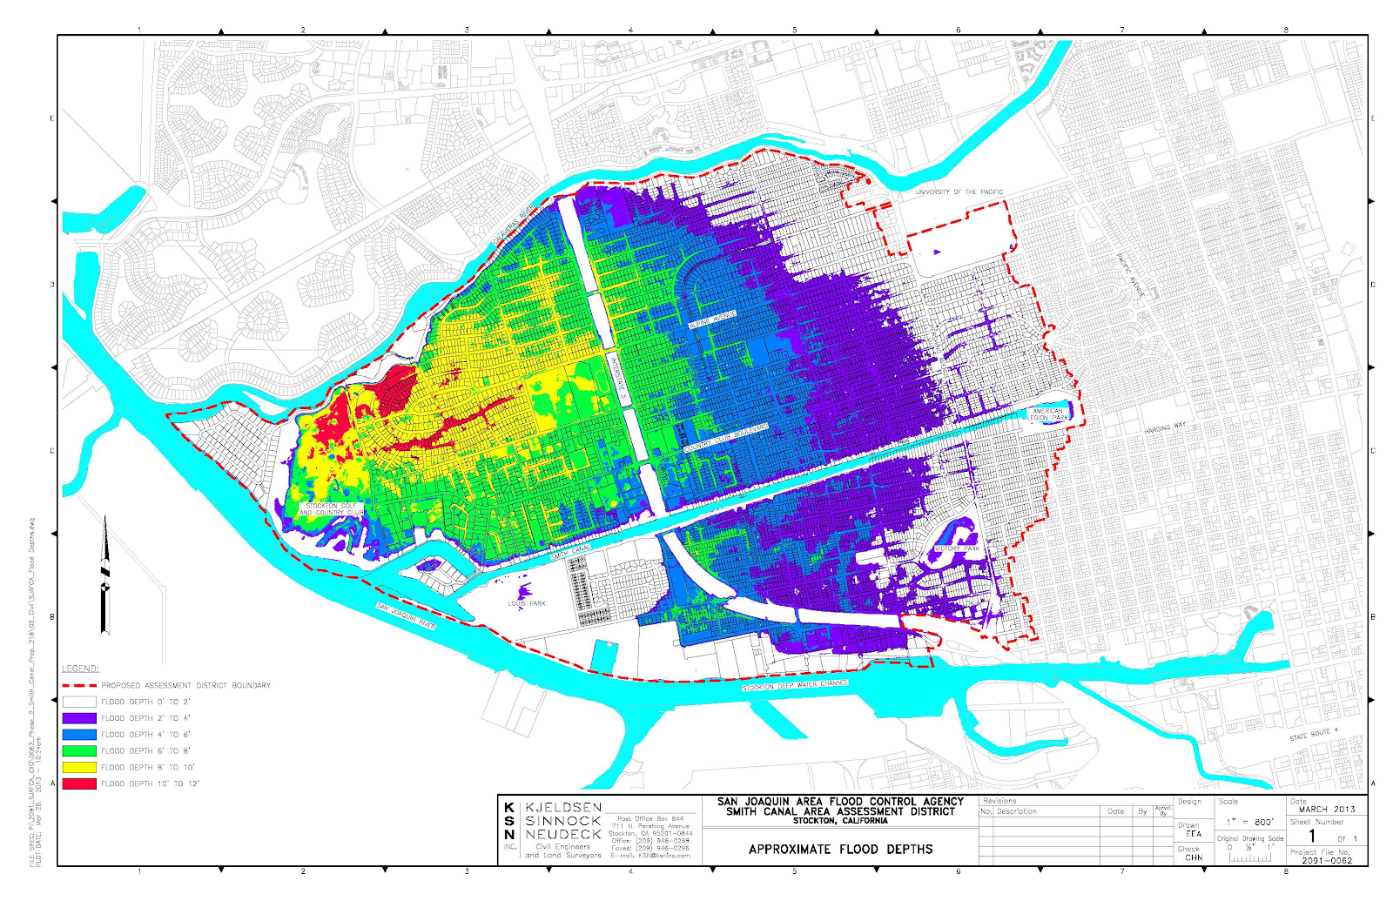
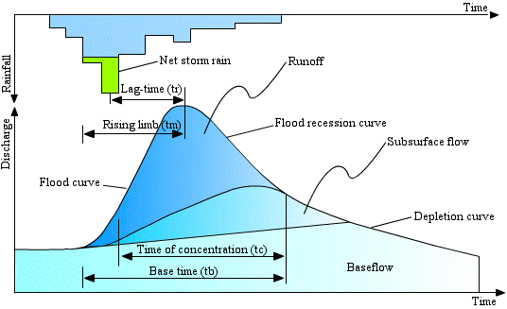
Proposal
Water Flow Mapping and Auto Alert to Citizens
Concentration Time
Alert Citizens Before Overflow
Reduce the Damage
Real-time

Slide 5
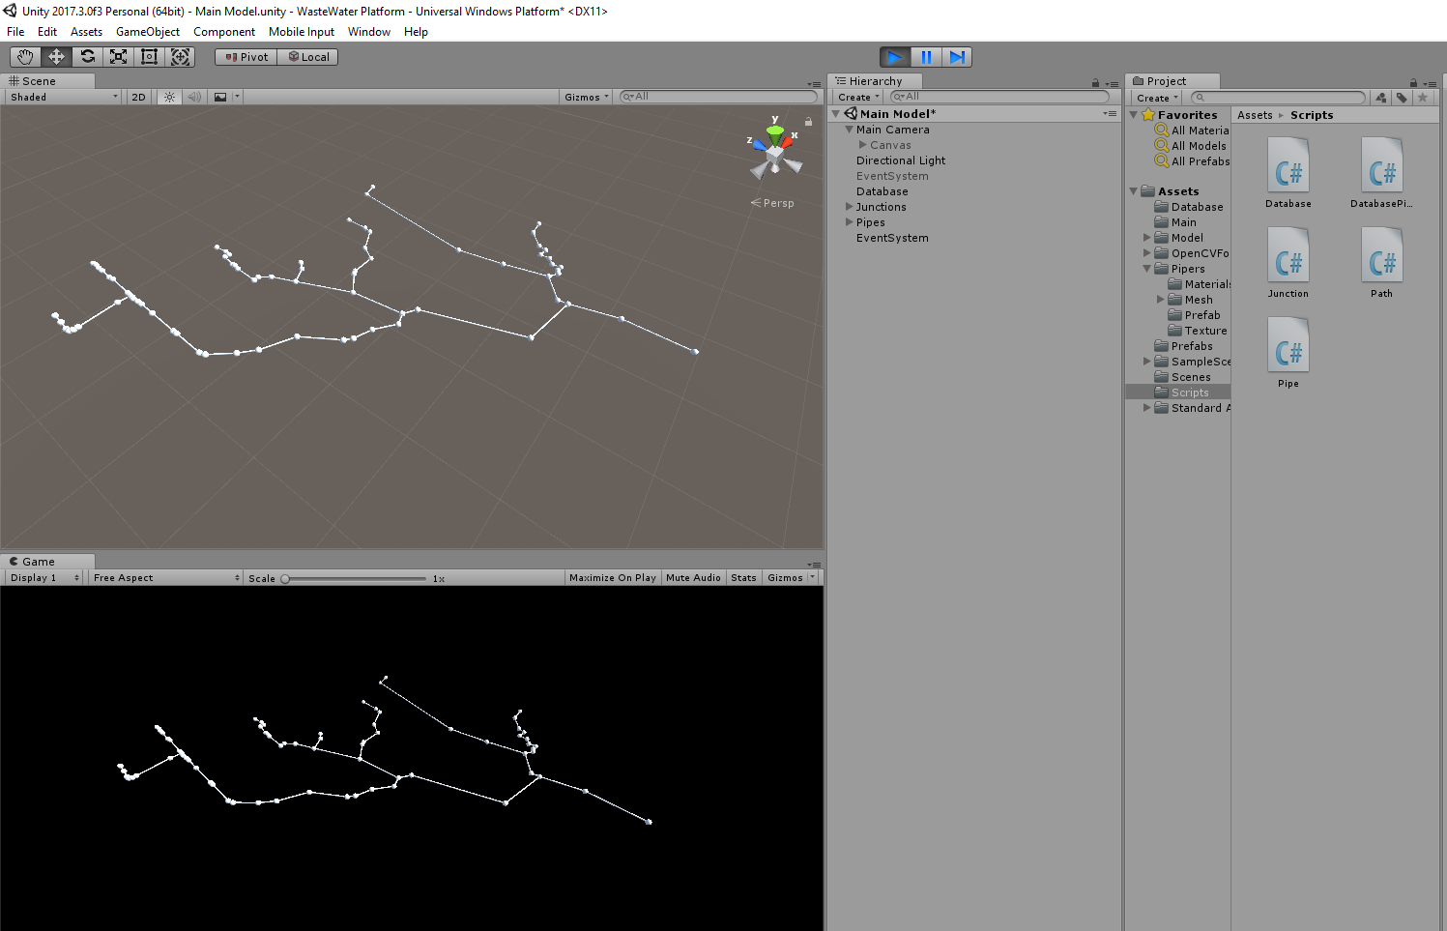
Unity Model
Water Flow Mapping and Auto Alert to Citizens

Slide 6

Unity Model
Water Flow Mapping and Auto Alert to Citizens

Slide 7
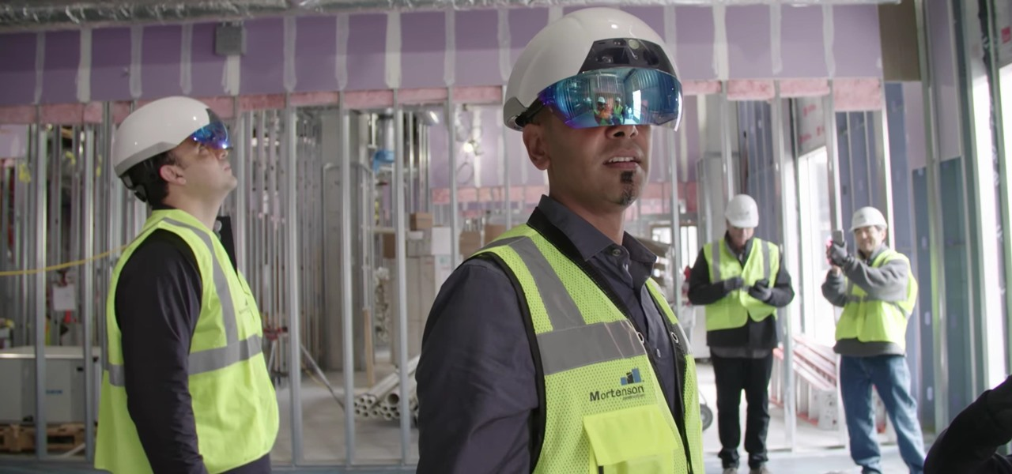
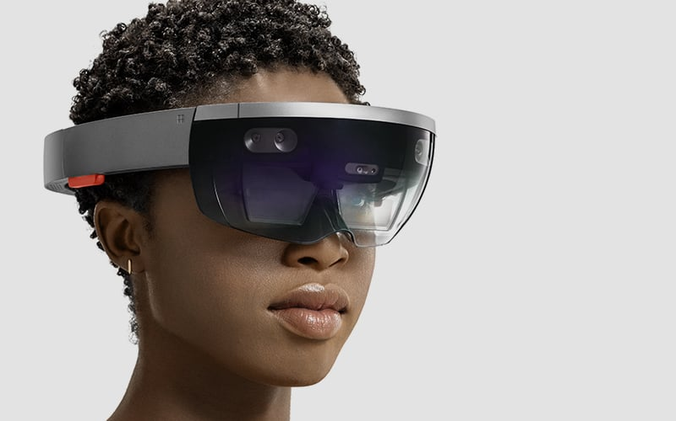
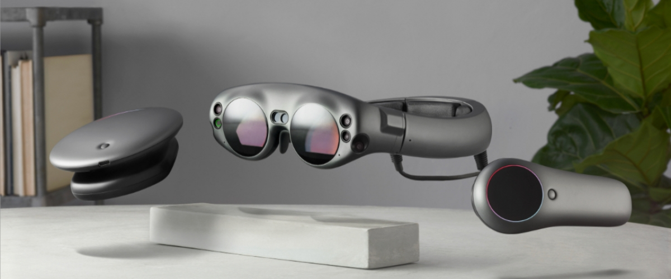
Proposal
Mixed Reality
Notes:
*I reserved one hololens for next week.

Slide 8
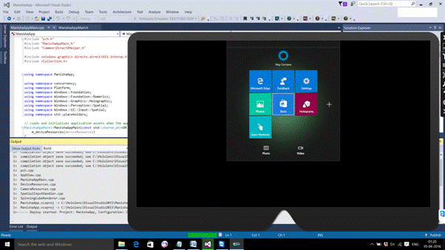
Proposal
Mixed Reality Emulator
Notes:
*I reserved one hololens for next week.

Slide 9
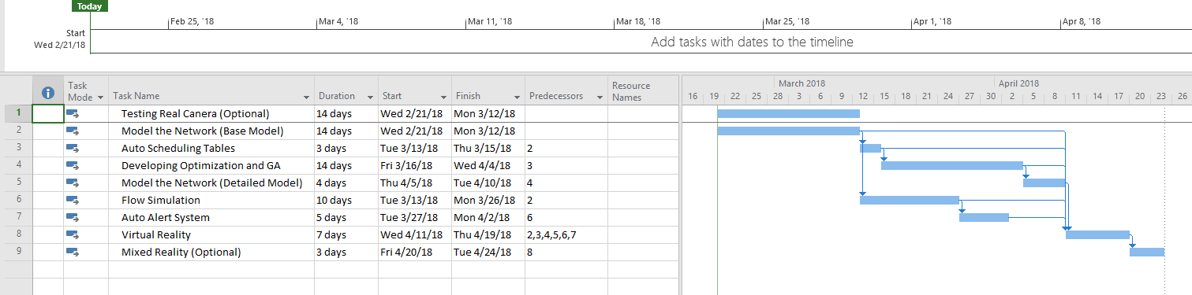
Timeline
Task Name | Duration | Start | Finish | Predecessors
Testing Real Canera (Optional) | 14 days | Wed 2/21/18 | Mon 3/12/18
Model the Network (Base Model) | 14 days | Wed 2/21/18 | Mon 3/12/18
Auto Scheduling Tables | 3 days | Tue 3/13/18 | Thu 3/15/18 | 2
Developing Optimization and GA | 14 days | Fri 3/16/18 | Wed 4/4/18 | 3
Model the Network (Detailed Model) | 4 days | Thu 4/5/18 | Tue 4/10/18 | 4
Flow Simulation | 10 days | Tue 3/13/18 | Mon 3/26/18 | 2
Auto Alert System | 5 days | Tue 3/27/18 | Mon 4/2/18 | 6
Virtual Reality | 7 days | Wed 4/11/18 | Thu 4/19/18 | 2,3,4,5,6,7
Mixed Reality (Optional) | 3 days | Fri 4/20/18 | Tue 4/24/18 | 8

Slide 10
Thank You

